Slide 1
Fundamentals of Electric Transmission System Planning Short Course Static Power System Analysis Tools
Scott Dahman
PowerWorld Corporation
scott@powerworld.com
March 19-21, 2024
© copyright Tom Overbye, 2024

Slide 2
Overview
This talk covers several static power system analysis techniques that build on the power flow
Contingency Analysis: does the automatic processing of a potentially large number of “what if” scenarios
Sensitivity Analysis: looks at how the system values change using a linear approximation
Static voltage stability analysis: considers how the system voltage changes, potentially up to the point of maximum loadability
All these tools are widely used in transmission system planning

Slide 3
Contingency Analysis
Contingency analysis is the process of checking the impact of statistically likely contingencies
Example contingencies include the loss of a generator, the loss of a transmission line or the loss of all transmission lines in a common corridor
Statistically likely contingencies can be quite involved, and might include automatic or operator actions
Reliable power system operation requires that the system be able to operate with no unacceptable violations even when these contingencies occur
N-1 reliable operation considers single elements

Slide 4
Contingency Analysis
This process can be automated with the usual approach of first defining a contingency set, and then sequentially applying the contingencies and checking for violations
This process can naturally be done in parallel
Contingency sets can get quite large, especially if one considers N-2 (outages of two elements) or N-1-1 (initial outage, followed by adjustment, then second outage
The assumption is usually most contingencies will not cause problems, so screening methods can be used to quickly eliminate many

Slide 5
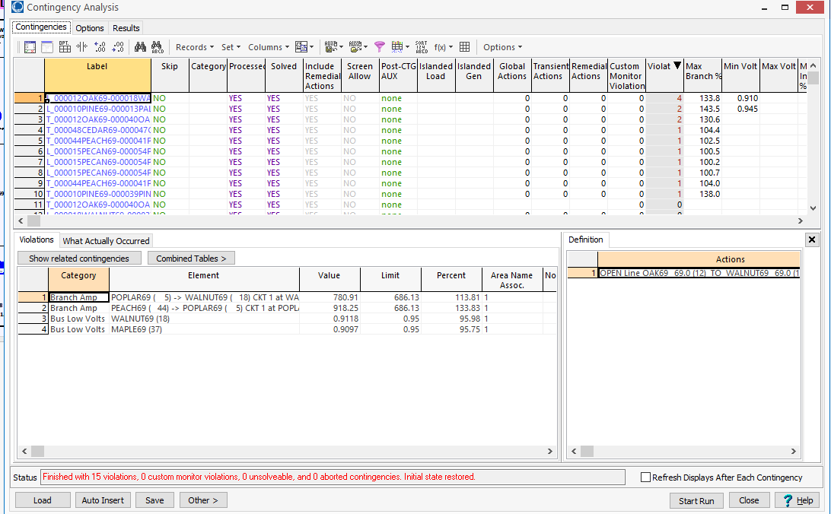
Contingency Example: Small System
In PowerWorld open the PSC_37Bus case, and select Tools, Contingency Analysis, then click Start Run
While contingency analysis is simple to describe, many issues need to be considered in a contingent solution. For example, how much time is assumed for post-contingent control actions.

Slide 6
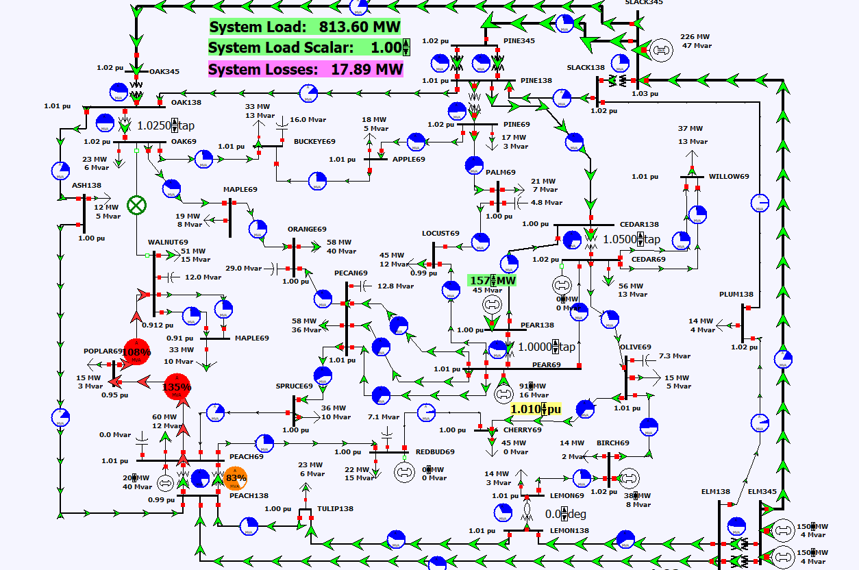
Contingency Example: Small System, cont.
Contingency analysis reveals a planning challenge!
For the Oak69-Walnut69 contingency, Walnut69 is radial with overloads on two lines. Consider options to remove these overloads.

Slide 7
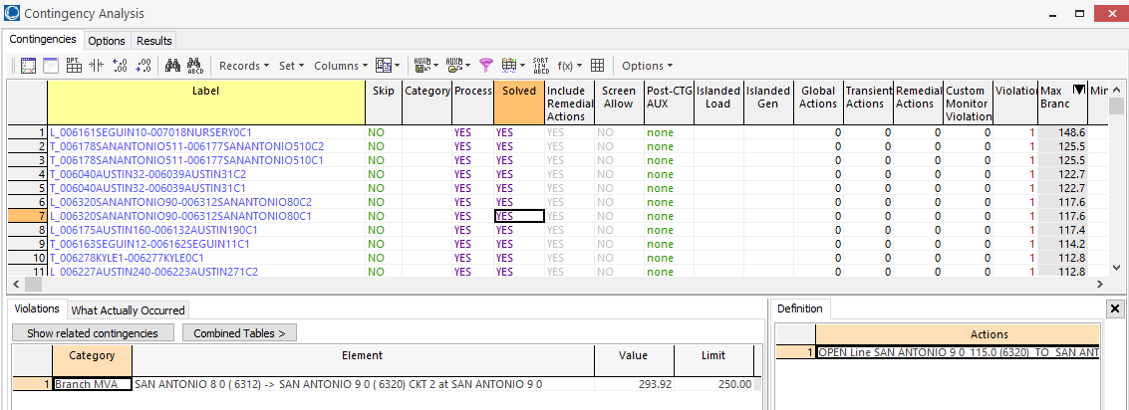
Contingency Example: 2000 Bus System
Next, open the PSC_2000_PowerFlow case, which has 616 contingencies defined for the Southeast area
Contingency analysis is a naturally parallel application; computation can also be reduced using approximate techniques

Slide 8
Power Flow Topology Processing
Commercial power flow software must have algorithms to determine the number of asynchronous, interconnected systems in the model
These separate systems are known as Islands
In large system models such as the Eastern Interconnect it is common to have multiple islands in the base case (one recent EI model had nine islands)
Islands can also form unexpectedly as a result of contingencies
Power can be transferred between islands using dc lines
Each island must have a slack bus

Slide 9
Power Flow Topology Processing
Anytime a status change occurs the power flow must perform topology processing to determine whether there are either 1) new islands or 2) islands have merged
Determination is needed to determine whether the island is “viable.” That is, could it truly function as an independent system, or should the buses just be marked as dead?
A quite common occurrence is when a single load or generator is isolated; in the case of a load it can be immediately killed; generators are more tricky
Topology processing is quick (order N (ln(N))

Slide 10
Power System Control and Sensitivities
A major issue with power system planning and operations is the limited capacity of the transmission system
lines/transformers have limits (usually thermal)
no direct way of controlling flow down a transmission line (e.g., there are no valves to close to limit flow)
open transmission system access (with industry restructuring) is stressing the system in new ways
We need to indirectly control transmission line flow by changing the generator outputs
Similar control issues with voltage magnitude

Slide 11
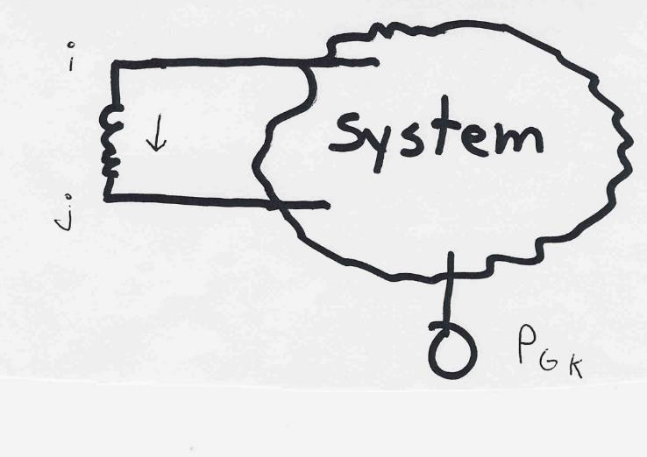
Indirect Transmission Line Control
What we would like to determine is how a change in generation at bus k affects the power flow on a line from bus i to bus j.
The assumption is
that the change
in generation is
absorbed by the
slack bus

Slide 12
Power Flow Simulation - Before
One way to determine the impact of a generator change is to compare a before/after power flow.
For example below is a three bus case with an overload

Slide 13
Power Flow Simulation - After
Increasing the generation at bus 3 by 95 MW (and hence decreasing it at bus 1 by a corresponding amount), results in a 30.3 MW drop in the MW flow on the line from bus 1 to 2, and a 64.7 MW drop on the flow from 1 to 3.
Expressed as a percent, 30.3/95 =32% and 64.7/95=68%

Slide 14
Analytic Calculation of Sensitivities
Calculating control sensitivities by repeat power flow solutions is tedious and would require many power flow solutions. An alternative approach is to analytically calculate these values
Here we’ll talk about how to use these values without getting into the math of how they are calculated (except to comment on the computational aspects)

Slide 15
Injection Shift Factors (ISFs)
A common sensitivity value is known as the injection shift factor (ISF), denoted here as , where l is a line and n is an injection bus
Terms generation shift factor (GSF) and load shift factor (LSF) are also used (such as by NERC)
Same concept, just a variation in the sign whether it is a generator or a load
Sometimes the associated element is not a single line, but rather a combination of lines (an interface)
Terms used by NERC are in its glossary (http://www.nerc.com/files/glossary_of_terms.pdf)

Slide 16
Injection Shift Factors (ISFs)
The magnitude of an ISF is bounded between -1 and 1 (though it could be slightly outside this range if losses are considered)
Depends on location of the slack bus (i.e., the sink), and is zero at the slack bus
Computationally ISFs are quick to calculate
Either a forward/backward substitution for all (order N1.2) or quicker for less with sparse vector methods
Multiple ISFs can be calculated either of many buses and one line, or for many lines and one bus

Slide 17
ISF Visualization
Calculated in PowerWorld for Case PSC_37ISF using Tools, Sensitivities, PTDFs
The oneline shows the ISFs for the Pear138 bus (source) for all system lines with the change absorbed at Slack345 (sink)

Slide 18
Power Transfer Distribution Factors (PTDFs)
PTDFs are built from ISFs for multiple sources and sinks
NERC defines a PTDF as
“In the pre-contingency configuration of a system under study, a measure of the responsiveness or change in electrical loadings on transmission system Facilities due to a change in electric power transfer from one area to another, expressed in percent (up to 100%) of the change in power transfer”
PTDFs depend on the seller (source) area (i.e. a set of ISFs) and a buyer (sink) area

Slide 19
Power Transfer Distribution Factors (PTDFs), cont.
PTDFs are used to determine how a particular transaction affects system elements (e.g., lines, flowgates, paths)
From a seller to a buyer
The PTDFs from a single generator to the slack bus is the same as ISFs for that bus
PowerWorld Simulator uses Injection Groups to allow for quick PTDF calculations with complex sets of sellers and buyers

Slide 20
Line Outage Distribution Factors (LODFs)
Power system operation is practically always limited by contingencies, with line outages comprising a large number of the contingencies
Desire is to determine the impact of a line outage (either a transmission line or a transformer) on other system real power flows without having to explicitly solve the power flow for the contingency
These values are provided by the LODFs

Slide 21
Line Outage Distribution Factors (LODFs)
The LODF is the portion of the pre-outage real power line flow on line k that is redistributed to line l as a result of the outage of line k
The LODFs are calculated using the ISFs (actually PTDFs for transactions between the ends of the lines)
The LODFs calculation will fail if the outaged line islands the system

Slide 22
LODFs Calculation Example
Open the PSC_37Bus case and select Tools, Sensitivities, LODFs
Calculate the LODFs for an outage of the Pine138 (bus 39)-Pine69 (bus 10) transformer
Note that the flow on the Pine138 (bus 39) to Cedar138 (bus 47) line is estimated to change from 87.6 to 128.7 MW
Solve the power flow to verify that this value is correct (keeping in mind it is a linear estimate)
The advantages of the LODFs is that they can be calculated quickly (order N^{1.2})

Slide 23
Multiple Line LODFs and LCDFs
LODFs can also be used to represent multiple device contingencies, but it is usually more involved than just adding the effects of the single device LODFs if the contingencies usually interact
We can also calculate line closure distribution factors (LCDFs), where LCDF_{j,k}, for the closure of line k is the portion of the line active power flow on line k that is distributed to line j due to the closure of line k
LCDFs can be useful for planning since line k need not actually currently exist!

Slide 24
Outage Transfer Distribution Factor (OTDF)
The outage transfer distribution factor (OTDF) is defined as the PTDF with the line k outaged
The OTDF applies only to the post-contingency configuration of the system since its evaluation explicitly considers the line k outage
This is a quite important value since power system operation is usually contingency constrained
Used in linear Available Transfer Capability (ATC) calculation

Slide 25
August 14, 2003 OTDF Example
Flowgate 2264 monitored the flow on Star-Juniper 345 kV line for loss of Hanna-Juniper 345 kV
Normally the LODF for this flowgate is 0.361
flowgate had a limit of 1080 MW
at 15:05 EDT the flow as 517 MW on Star-Juniper, 1004 MW on Hanna-Juniper, giving a flowgate value of 520+0.361*1007=884 (82%)
Chamberlin-Harding opened at 15:05, but was missed
At 15:06 EDT (after loss of Chamberlin-Harding 345) #2265 had an incorrect value (LODF was not updated)
Value should be 633+0.463*1174=1176 (109%)
Value was 633 + 0.361*1174=1057 (98%)

Slide 26
Small Disturbance Voltage Collapse (PV and QV Curves)
At constant frequency (e.g., 60 Hz) the complex power transferred in a line is S=VI*
V is phasor voltage, I is phasor current
This is the reason for using a high voltage grid
Line real power losses are given by RI² and reactive power losses by XI²
R is the line’s resistance, and X its reactance; for a high voltage line X >> R
Increased reactive power tends to drive down the voltage, which increases the current, which further increases the reactive power losses

Slide 27
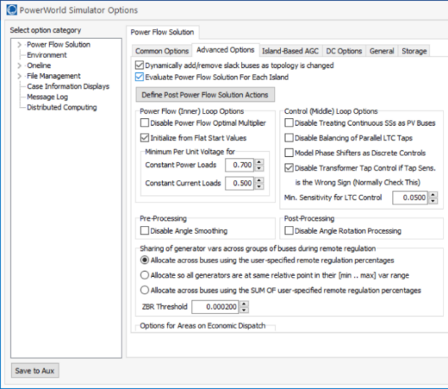
Maximum Loadability
The transmission system can only supply so much power (Case B2_Loadability)
Power flows can have multiple or no solutions
Commercial power flow software usually auto converts constant power loads at low voltages; set these fields to zero to disable this conversion

Slide 28
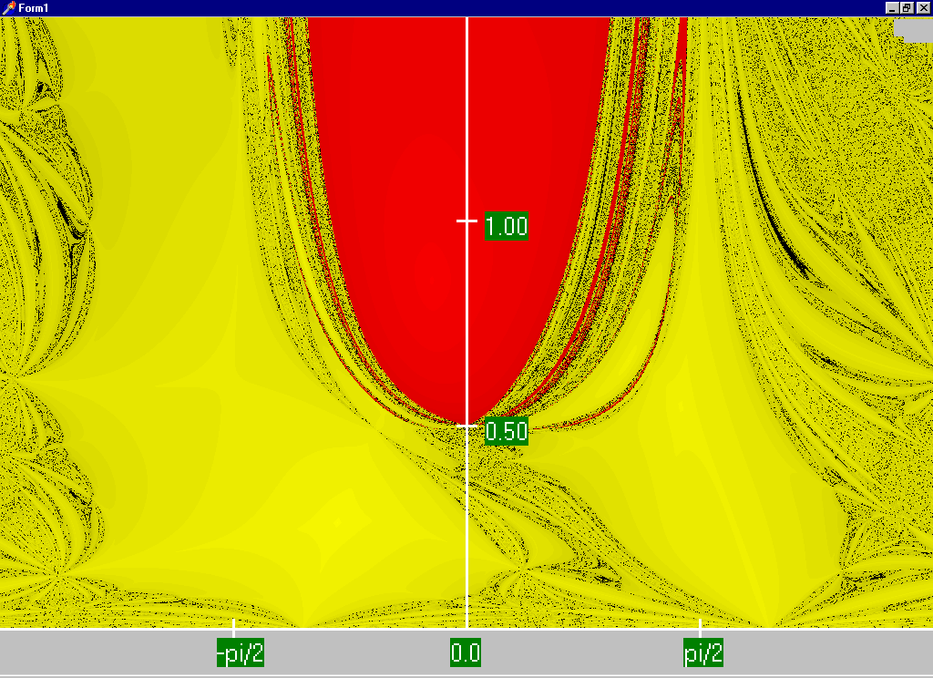
Power Flow Region of Convergence (Revisited)
Convergence regions for P=100 MW Q=0 Mvar
Set the load to these values, initialize Bus 2 at 0.5 pu, -90 deg, and re-solve the power flow.

Slide 29
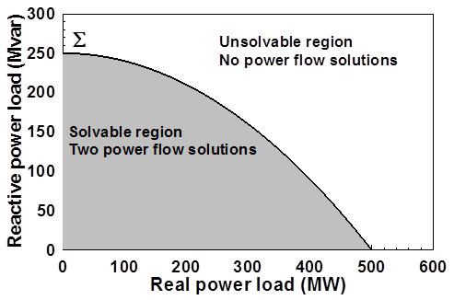
Load Parameter Space Representation
With a constant power model there is a maximum loadability surface, Σ
Defined as point in which the power flow Jacobian is singular
For the lossless two bus system it can be determined as

Slide 30
Load Model Impact
With a static load model regardless of the voltage dependency the same PV curve is traced
But whether a point of maximum loadability exists depends on the assumed load model
If voltage exponent is > 1 then multiple solutions do not exist (see B.C. Lesieutre, P.W. Sauer and M.A. Pai “Sufficient conditions on static load models for network solvability,” NAPS 1992, pp. 262-271)
Change load to constant impedance; hence it becomes a linear model

Slide 31
Determining a Metric to Voltage Collapse (Maximum Loadability)
The goal of much of the voltage stability work was to determine an easy to calculate metric (or metrics) of operating point to voltage collapse
PV and QV curves (or some combination) can determine such a metric along a particular path
Goal was to have a path independent metric. The closest boundary point was considered, but this could be quite misleading if the system was not going to move in that direction
Any linearization about the current operating point (i.e., the Jacobian) does not consider important nonlinearities like generators hitting their reactive power limits

Slide 32
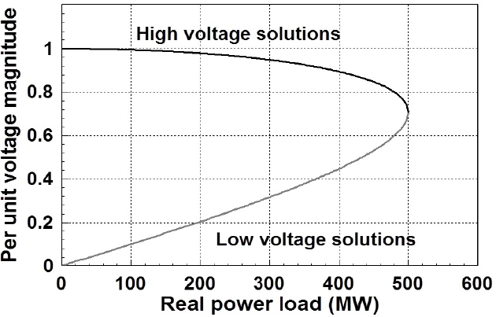
PV Analysis “Nose Curve”
The “nose point” is at 500 MW for a constant power load

Slide 33
PV and QV Analysis
Industry practice is to just pick a particular path, and trace the voltage as the system parameters are varied
If real power is varied this is known as a PV curve, whereas if the reactive power is varied it is known as a QV curve
Usually the power at a variety of devices is changed; in PowerWorld this requires setting up an injection group
PV/QV analysis then varies the injections in the injection groups, optionally considering contingencies

Slide 34
PV and QV Analysis, cont.
In PowerWorld the PV tool can be displayed by selecting Add-Ons, PV
Use the Setup page to define a source and a sink
Use the Quantities to Track page to define the values to track
Plots can be defined on the Plots page
Calculate the PV curve on the PV Results page. First check the Restore Initial State on Completion of Run, and then click Run

Slide 35
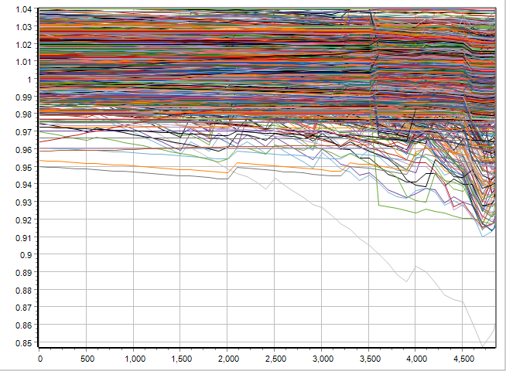
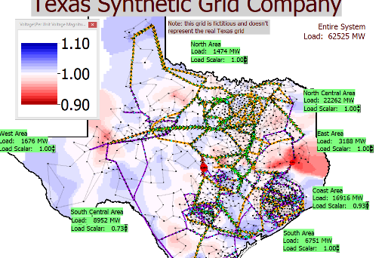
PV Results for 2000 Bus System
Open the case PSC_2000_PowerFlow_PVCurve
Source is set to South Central generation and the sink is the North Central generation
Run PV Analysis, skipping contingencies
System insight is needed to determine the buses to plot, though all can be selected as a starting point
All bus voltage magnitudes
4450 MW Transfer Contour

Slide 36
Questions?

